Slide 1
Flow of Control:
Branches
Creative Commons Attribution-NonCommercial-ShareAlike 3.0 Unported License. http://creativecommons.org/licenses/by-nc-sa/3.0/
Written by Rachel J. Morris, last updated 2015-01-14

Slide 2

Boolean Expressions
Creative Commons Attribution-NonCommercial-ShareAlike 3.0 Unported License. http://creativecommons.org/licenses/by-nc-sa/3.0/
Written by Rachel J. Morris, last updated 2015-01-14

Slide 3
Boolean Expressions
Before we work with “if, then” statements, we need to look at Boolean Expressions.
These are expressions that can either result in true or false.

Slide 4
Boolean Expressions
Here is a summary of boolean expressions
Conditional | C++
Equal to | ( var1 == var2 )
Not equal to | ( var1 != var2 )
Less than | ( var1 < var2 )
Less than or equal to | ( var1 <= var2 )
Greater than | ( var1 > var2 )
Greater than or equal to | ( var1 >= var2 )
True | ( var1 == true )
True, shorthand | ( var1 )
False | ( var1 == false )
False, shorthand | ( !var1 )

Slide 5
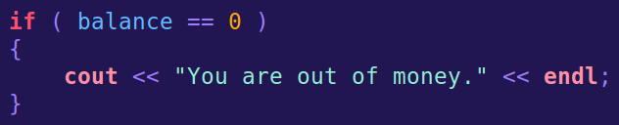
Boolean Expressions
Equal To
if ( var1 == var2 )
Compare whether two variables are equal, or if a variable equals some value,
(or if one value equals another value)
With the equality comparison operator ==.

Slide 6
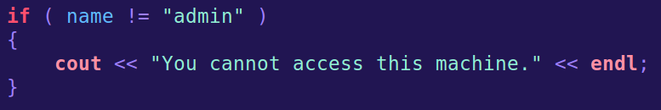
Boolean Expressions
Not Equal To
if ( var1 != var2 )
Likewise, you can check whether things are not equivalent with the != operator.

Slide 7
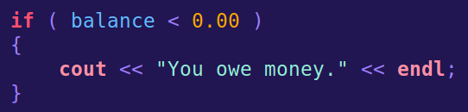
Boolean Expressions
Greater than / Less than
if ( var1 > var2 )
if ( var1 < var2 )
Used to compare numbers.

Slide 8
Boolean Expressions
Not Equal To
if ( var1 != var2 )
Likewise, you can check whether things are not equivalent with the != operator.

Slide 9
Boolean Expressions
Not Equal To
if ( var1 != var2 )
Likewise, you can check whether things are not equivalent with the != operator.

Slide 10
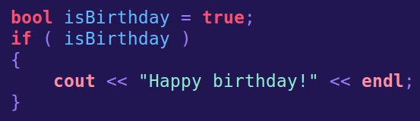
Boolean Expressions
If True
if ( var1 == true )
if ( var1 )
Used for booleans, or expressions that result in booleans (such as boolean expressions!)

Slide 11
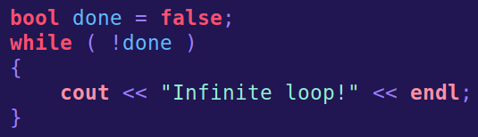
Boolean Expressions
If False
if ( var1 != true )
if ( !var1 )
Used for booleans, or expressions that result in booleans (such as boolean expressions!)

Slide 12
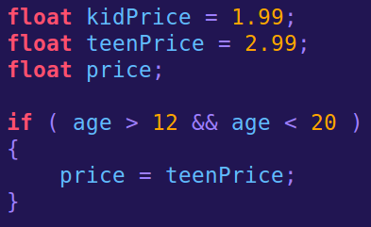
Boolean Expressions
We can also string together any amount of boolean expressions with the and && and or || operators.
If age is between 12 and 20.
12 < age < 20

Slide 13
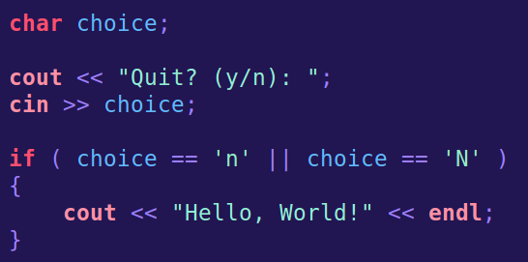
Boolean Expressions
We can also string together any amount of boolean expressions with the and && and or || operators.
If input is lower-case or upper-case “N”

Slide 14

If Statements
Creative Commons Attribution-NonCommercial-ShareAlike 3.0 Unported License. http://creativecommons.org/licenses/by-nc-sa/3.0/
Written by Rachel J. Morris, last updated 2015-01-14

Slide 15
If Statements
One of the main methods of branching logic in your program is through if statements.

Slide 16
If Statements
IF
You can use an if statement to check one condition, and skip over a block of code when false
Condition
true
false
Optional
Next Step

Slide 17
If Statements
IF - ELSE
You can test one condition and have two separate outcomes with IF – ELSE.
Condition
False
(else do this)
true
Optional A
Optional B
Next Step

Slide 18
If Statements
IF – ELSE IF
You can test multiple conditions with IF – ELSE IF (and, optionally, ELSE at the end for a “default” result)
Condition A
true
false
A
Condition B
true
B
false
Next Step

Slide 19
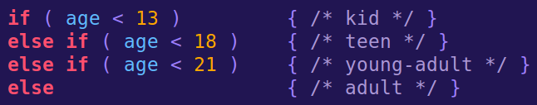
If Statements
IF – ELSE IF
You can chain as many else if conditionals as you would like, but there is only one if and only one (or zero) else for an
if-else if statement.

Slide 20
If Statements
IF – ELSE IF
With related if statements, whichever one evaluates to true first is the one that is executed, even if subsequent else if statements would also be true.
Here, if your age is 12, the first line would trigger, even though line 2 and line 3 are also true.

Slide 21
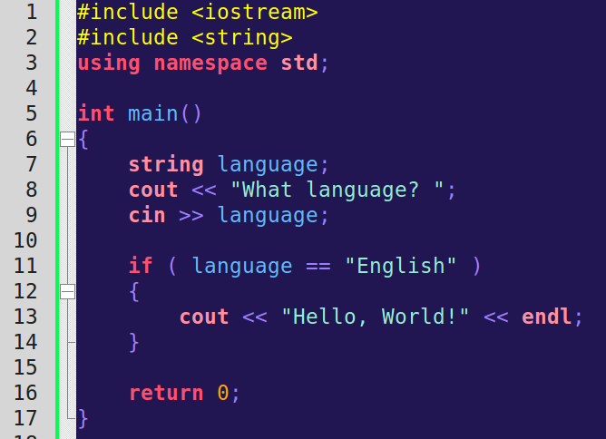
If Statements
If Statement
Language is English?
true
false
Display
“Hello, World!”
Return 0
Here, the user enters a language. They only get a Hello, World message if they enter “English”.

Slide 22
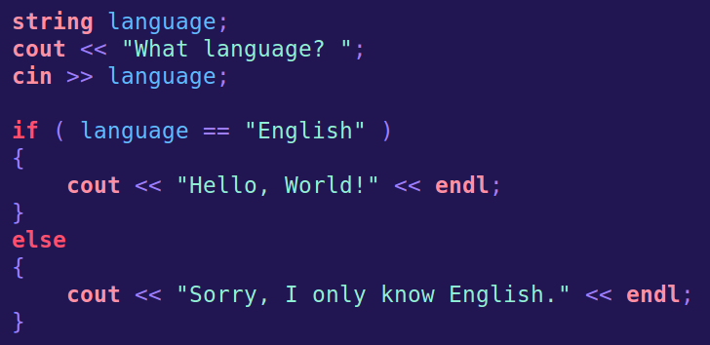
If Statements
If – Else Statement
Language is English?
true
false
Display
“Hello, World!”
Display
“only English”
Return 0
We can add an else statement, to give some default message.

Slide 23
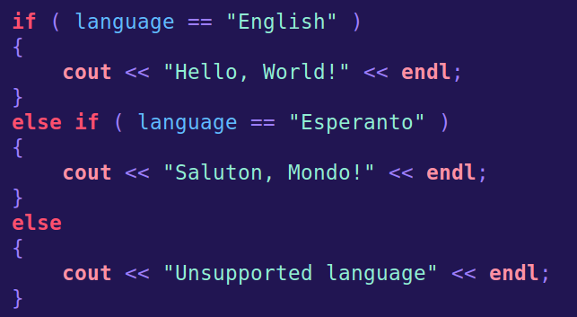
If Statements
If – Else If – Else Statement
Language is English?
true
false
“Hello, World!”
Language is Esperanto?
true
false
“Saluton, Mondo!”
“Unsupported”
Now we have two language options and the default.
We can keep adding options with more else if statements.

Slide 24
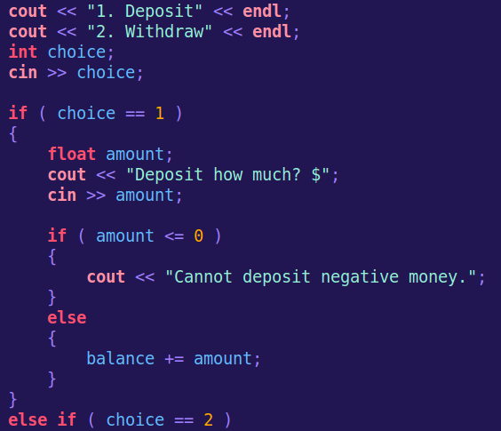
If Statements
Nesting If Statements
You can also contain if statements within other if statements. This allows additional branches in your program logic.

Slide 25

If Statements
Nesting If Statements
Just be careful to not over-clutter your program.
Later on, we will write functions to delegate tasks to other areas, instead of crowding main() with all the program logic.

Slide 26
Switches
Creative Commons Attribution-NonCommercial-ShareAlike 3.0 Unported License. http://creativecommons.org/licenses/by-nc-sa/3.0/
Written by Rachel J. Morris, last updated 2015-01-14

Slide 27
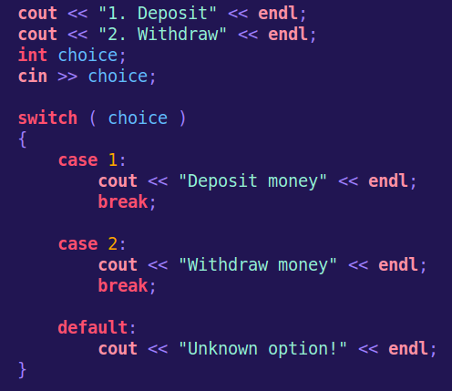
Switches
Another way to check conditions and branch for different values are with switch statements.
Switch statements can test boolean expressions, enums, integers, or characters.
They look a little odd compared to if statements.

Slide 28
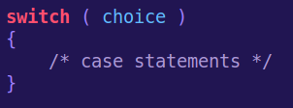
Switches
Switch statements start with the switch keyword.
The controlling expression is within parenthesis here.
The case statements that we write will be based on the value of the controlling expression. In this case, the expression is what the value of the integer choice is.

Slide 29
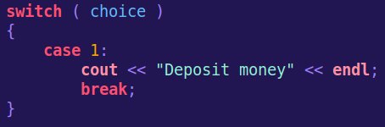
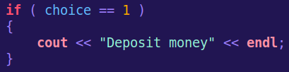
Switches
We can add case statements. After the keyword case, you specify the value we're testing for.
The switch statement and this if statement do the same thing.

Slide 30
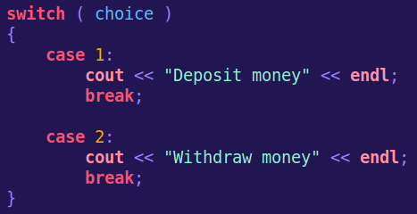
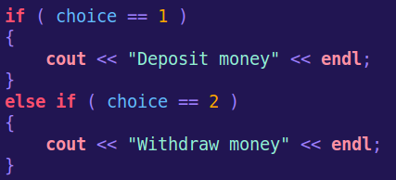
Switches
Notice that the case statements have a break; command before the next case statement.
When the break; is hit, it exits the switch statement. That way, it doesn't execute additional code under another case.

Slide 31
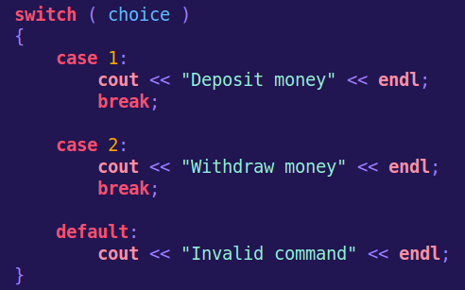
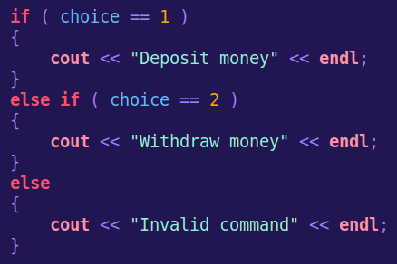
Switches
The default option is what is executed if none of the case statements match.
This would be similar to our else block.

Slide 32
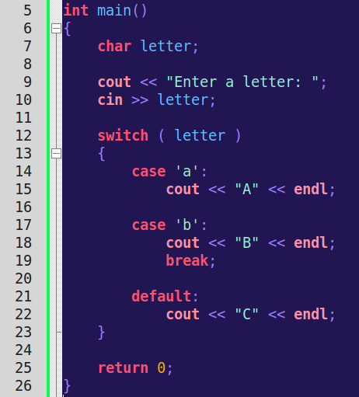


Switches
If we leave off the break; within a case, the code will “bleed through” into the next case block.

Slide 33
Time to code?

